Slide 1
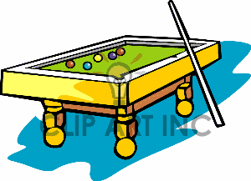
EQ: How can we use trigonometric ratios to find the value of unknown angles?

Slide 2

Trick shots

Slide 3
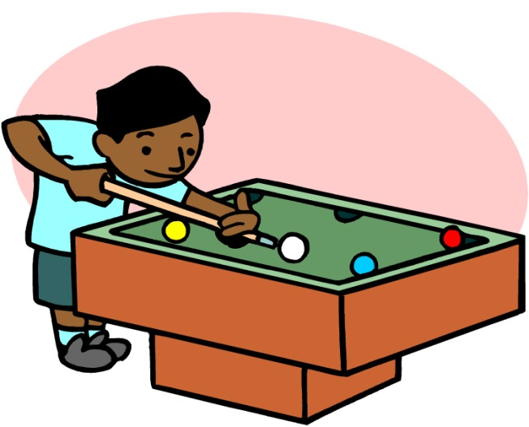
Will he make the shot?
Jimmy has just lost a game of pool and the white ball remains on the table. In his anguish, Jimmy decides to smash the white ball into a pocket.
He hits the ball on an angle of 60° to the end of the table.

Slide 4
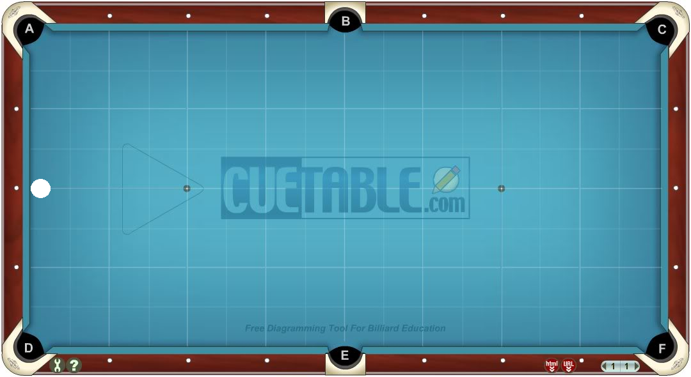

Does the ball go in pocket B?
8
OPP
Label sides
Which ratio?
SOH CAH TOA
Calculate the Angle.
$$tanθ=\frac{opp}{Adj}$$
$$tanθ=\frac{8}{4} \\ θ=\tan^{−1}{8/4} \\ θ=63.4°$$
4
ADJ
θ
The ball would miss pocket B

Slide 5

What angle does he need to get the ball in pocket c?
16
OPP
4
ADJ
θ
Label sides,
Which ratio? SOH CAH TOA
Calculate the Angle.
$$tanθ=\frac{opp}{Adj}$$
$$tanθ=\frac{16}{4} \\ θ=\tan^{−1}{16/4} \\ θ=76°$$

Slide 6
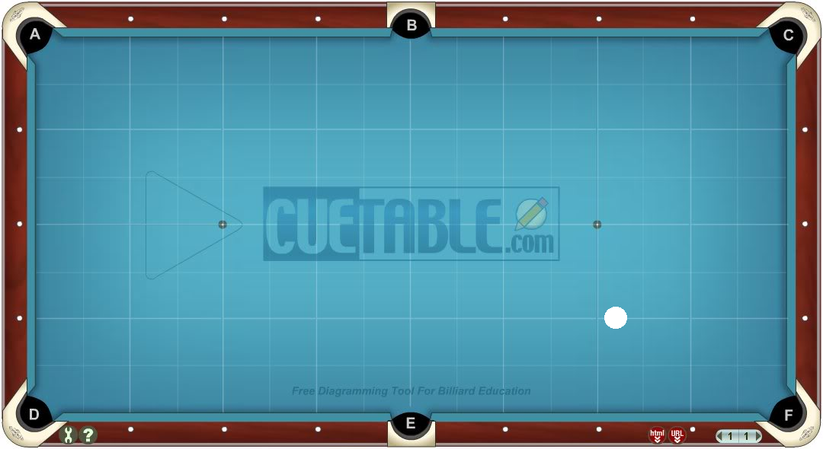

The ball is now 2 squares from the side and 4 squares from pocket F.
Label sides,
Which ratio? SOH CAH TOA
Calculate the Angle.
$$cosθ=\frac{Adj}{hyp}$$
$$cosθ=\frac{2}{4} \\ θ=\cos^{−1}{\frac{2}{4}} \\ θ=60°$$
θ
4
2

Slide 7
Practice
Complete the practice sheet

Slide 8
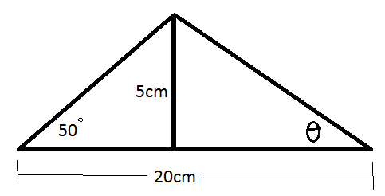
Challenge: Find the angle

Slide 9
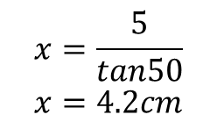
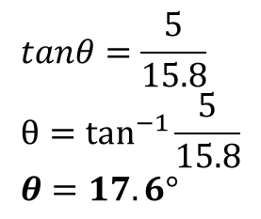
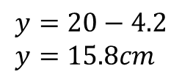
Solution
x
y
$$x=\frac{5}{tan50} \\ x=4.2cm$$
$$y=20−4.2 \\ y=15.8cm$$
$$tanθ=\frac{5}{15.8} \\ θ=\tan^{−1}{\frac{5}{15.8}} \\ θ=17.6°$$

